Slide 1
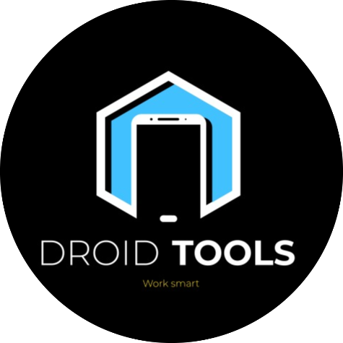
Welcome To
Droid Tools
The University Of Burdwan
Chandannagar Institute Of Management And Technology

Slide 2
Developers Name
Guide Name :
Amrita Banerjee (Internal Guide)
Souvik Bhattacharjee (External Guide)
Saheli Bala
Introduction
DroidTools
Basudeb Paul Chowdhury
DroidTools
DroidTools
Satyajit Swarnakar
DroidTools
Tanmoy Ghosh
Presentation Title

Slide 3

Objectives
Converter : The Primary objective of our app is to convert pdf file to text file , text file to pdf , image to text.
File Upload to Database : Following few steps we can upload important file or notes into the Server.
The objective of the application is to provide users with a convenient and efficient tool for converting files to different types. By utilizing this app, users can easily transform their documents, images, or any other supported file formats into the desired format. Also we provide features to store document of user in database to access from any device by login your profile.
File Access From Database : Which file you uploaded in the Server , that can be access from any device by login your account.
Quick Note : There is a feature in our app called Quick notes. Where we can write anything virtually that is stored in our Database in real time.

Slide 4
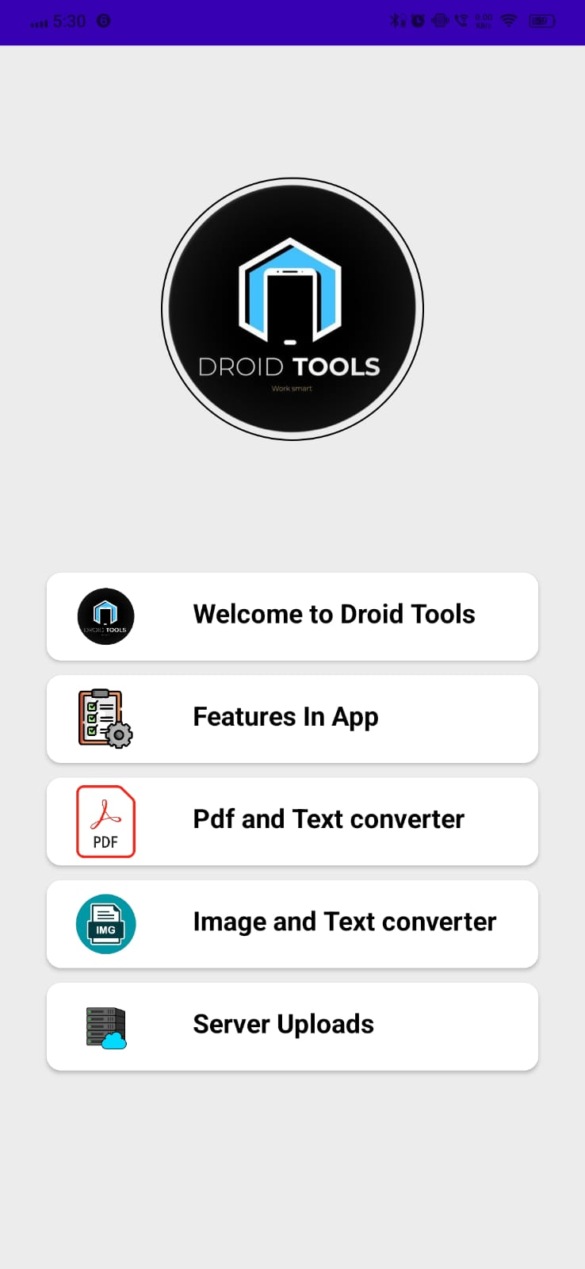
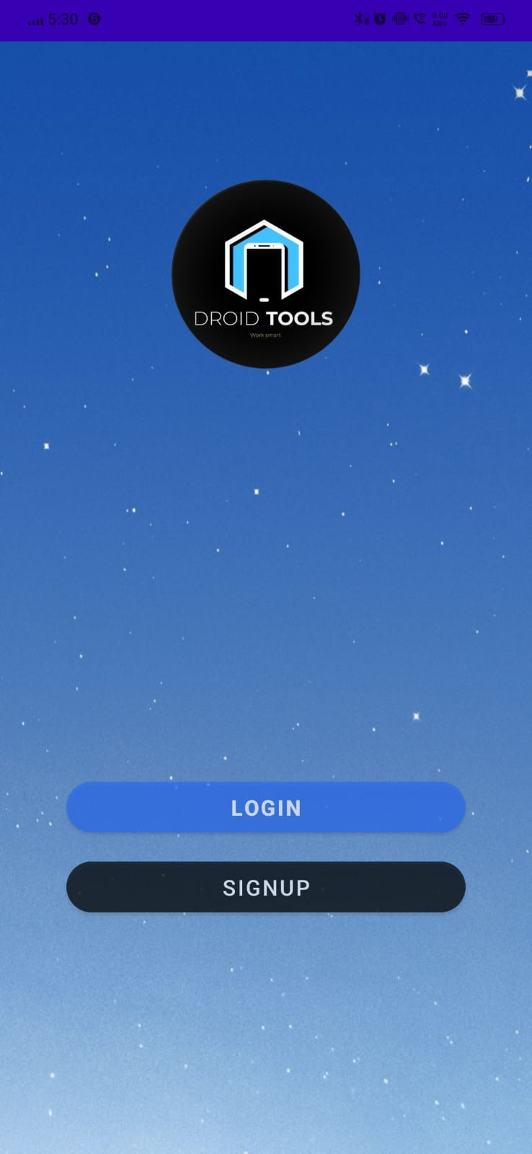

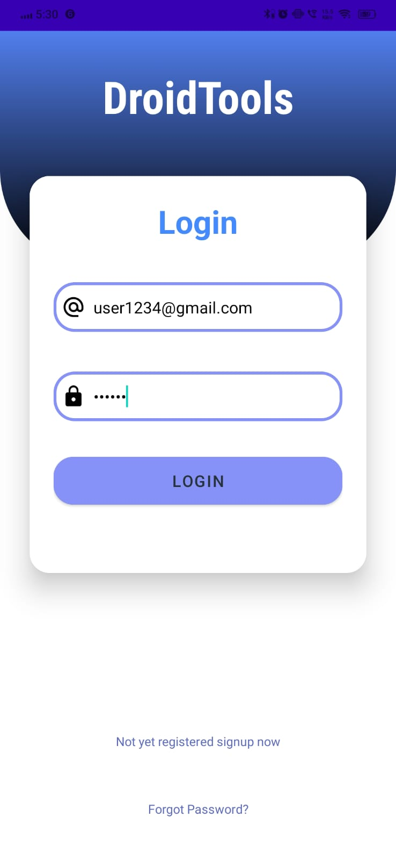
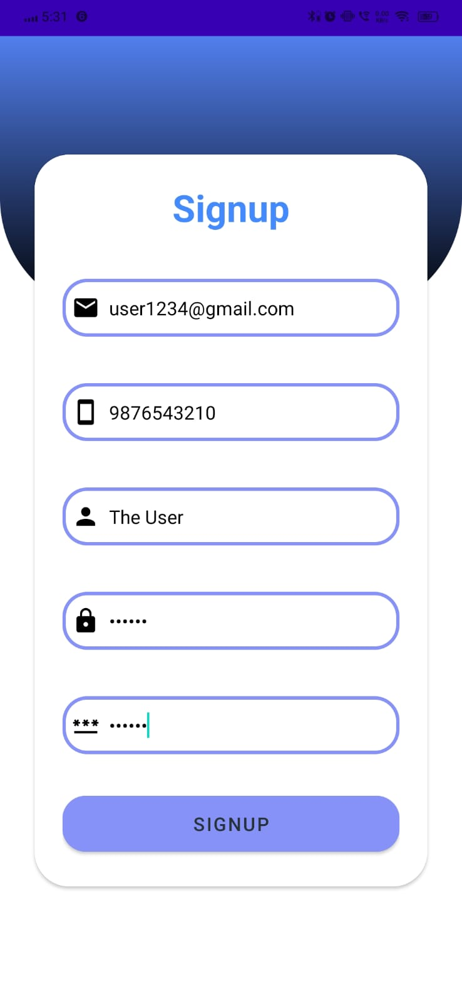
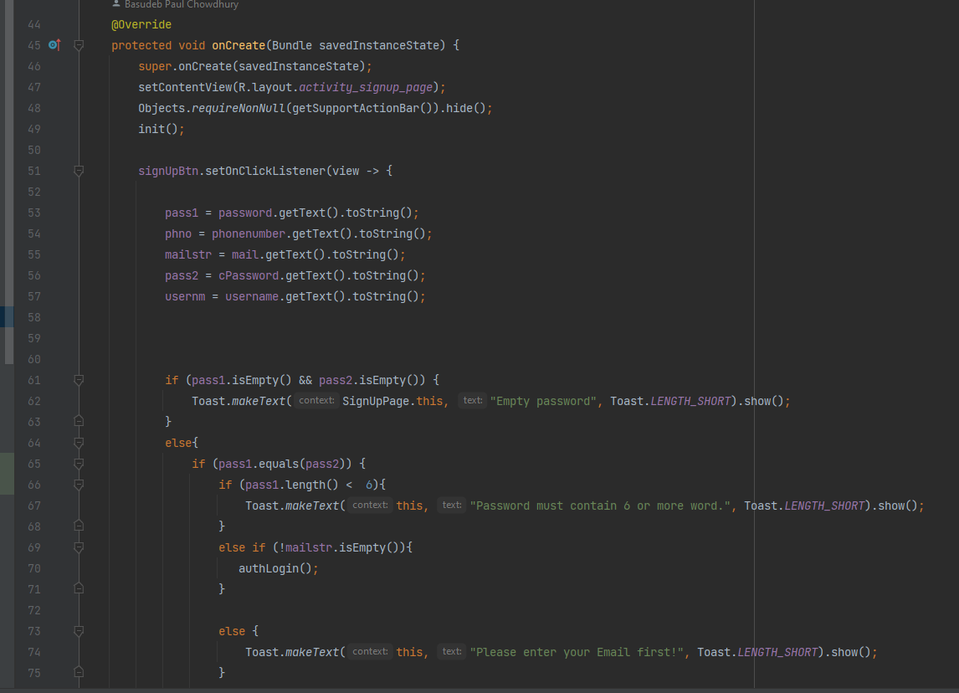

Snapshots One
Splash Screen
Login Or Signup Screen
Droid
tools
Signup Screen
Login Screen
Code of Signup

Slide 5
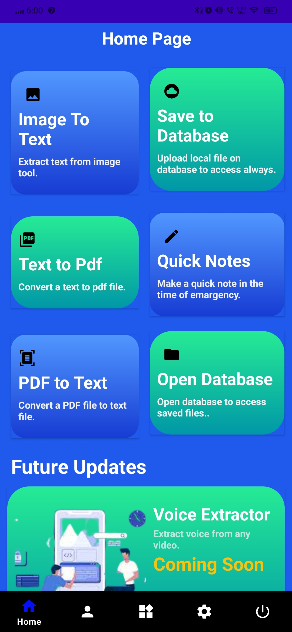
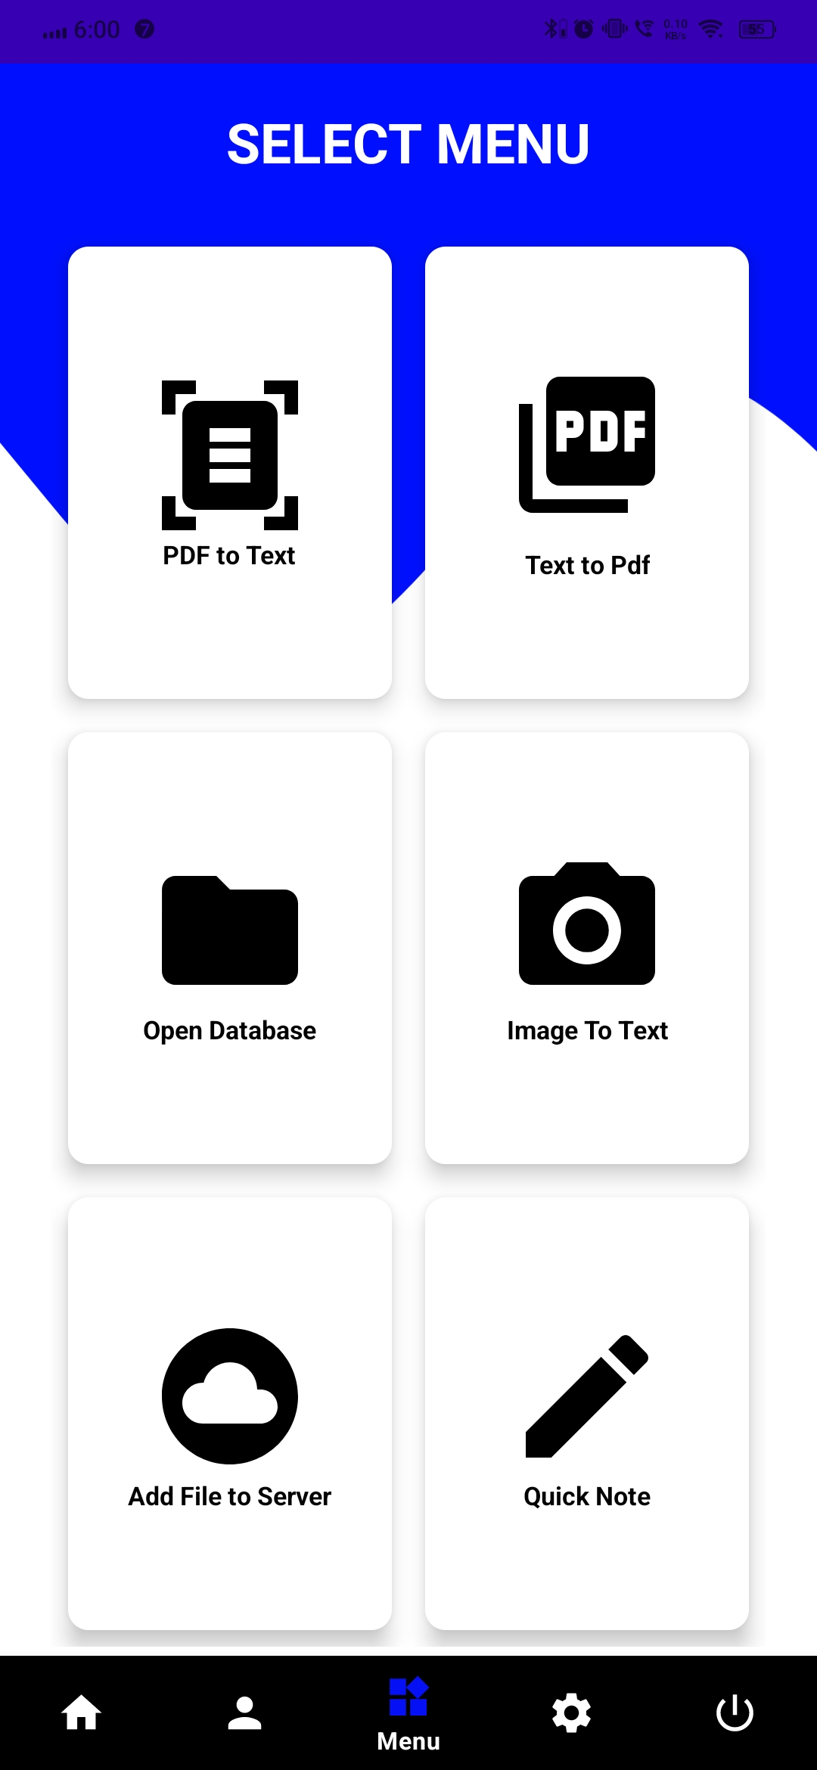
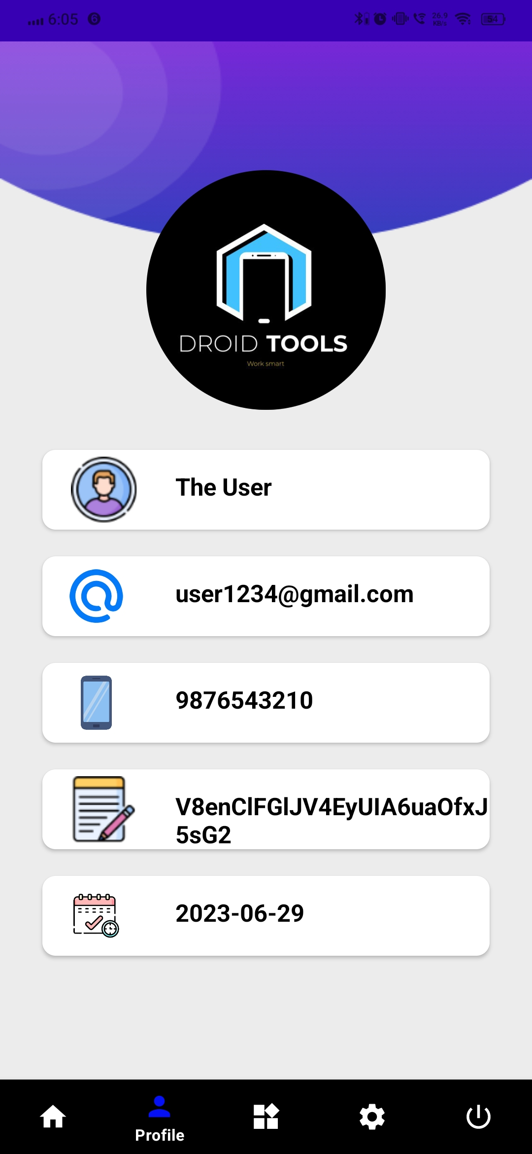
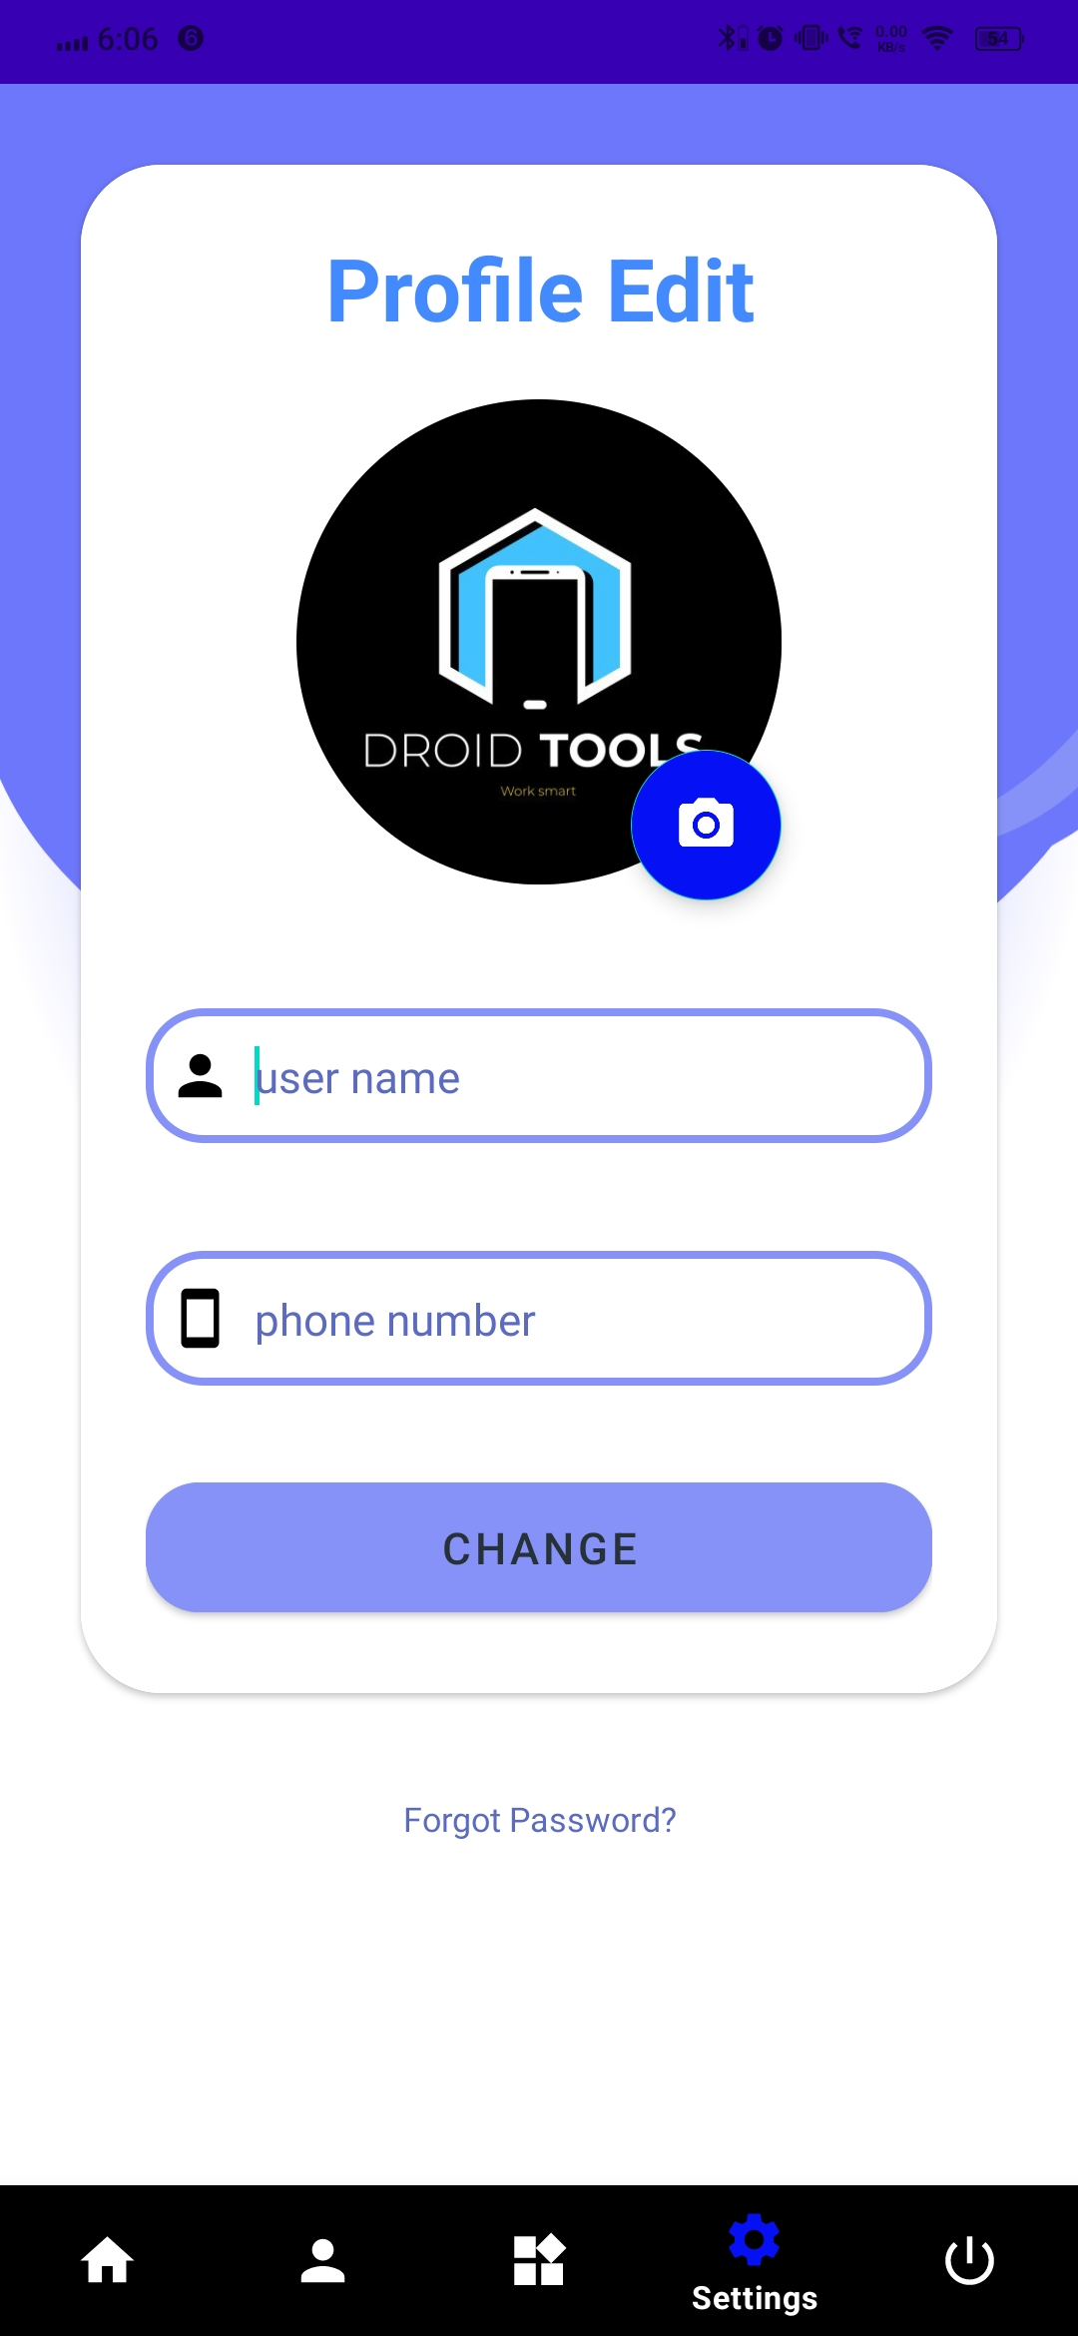
Snapshots Two
Menu Screen
Home Screen
Droid
tools
Edit
Profile Screen
Profile Screen

Slide 6
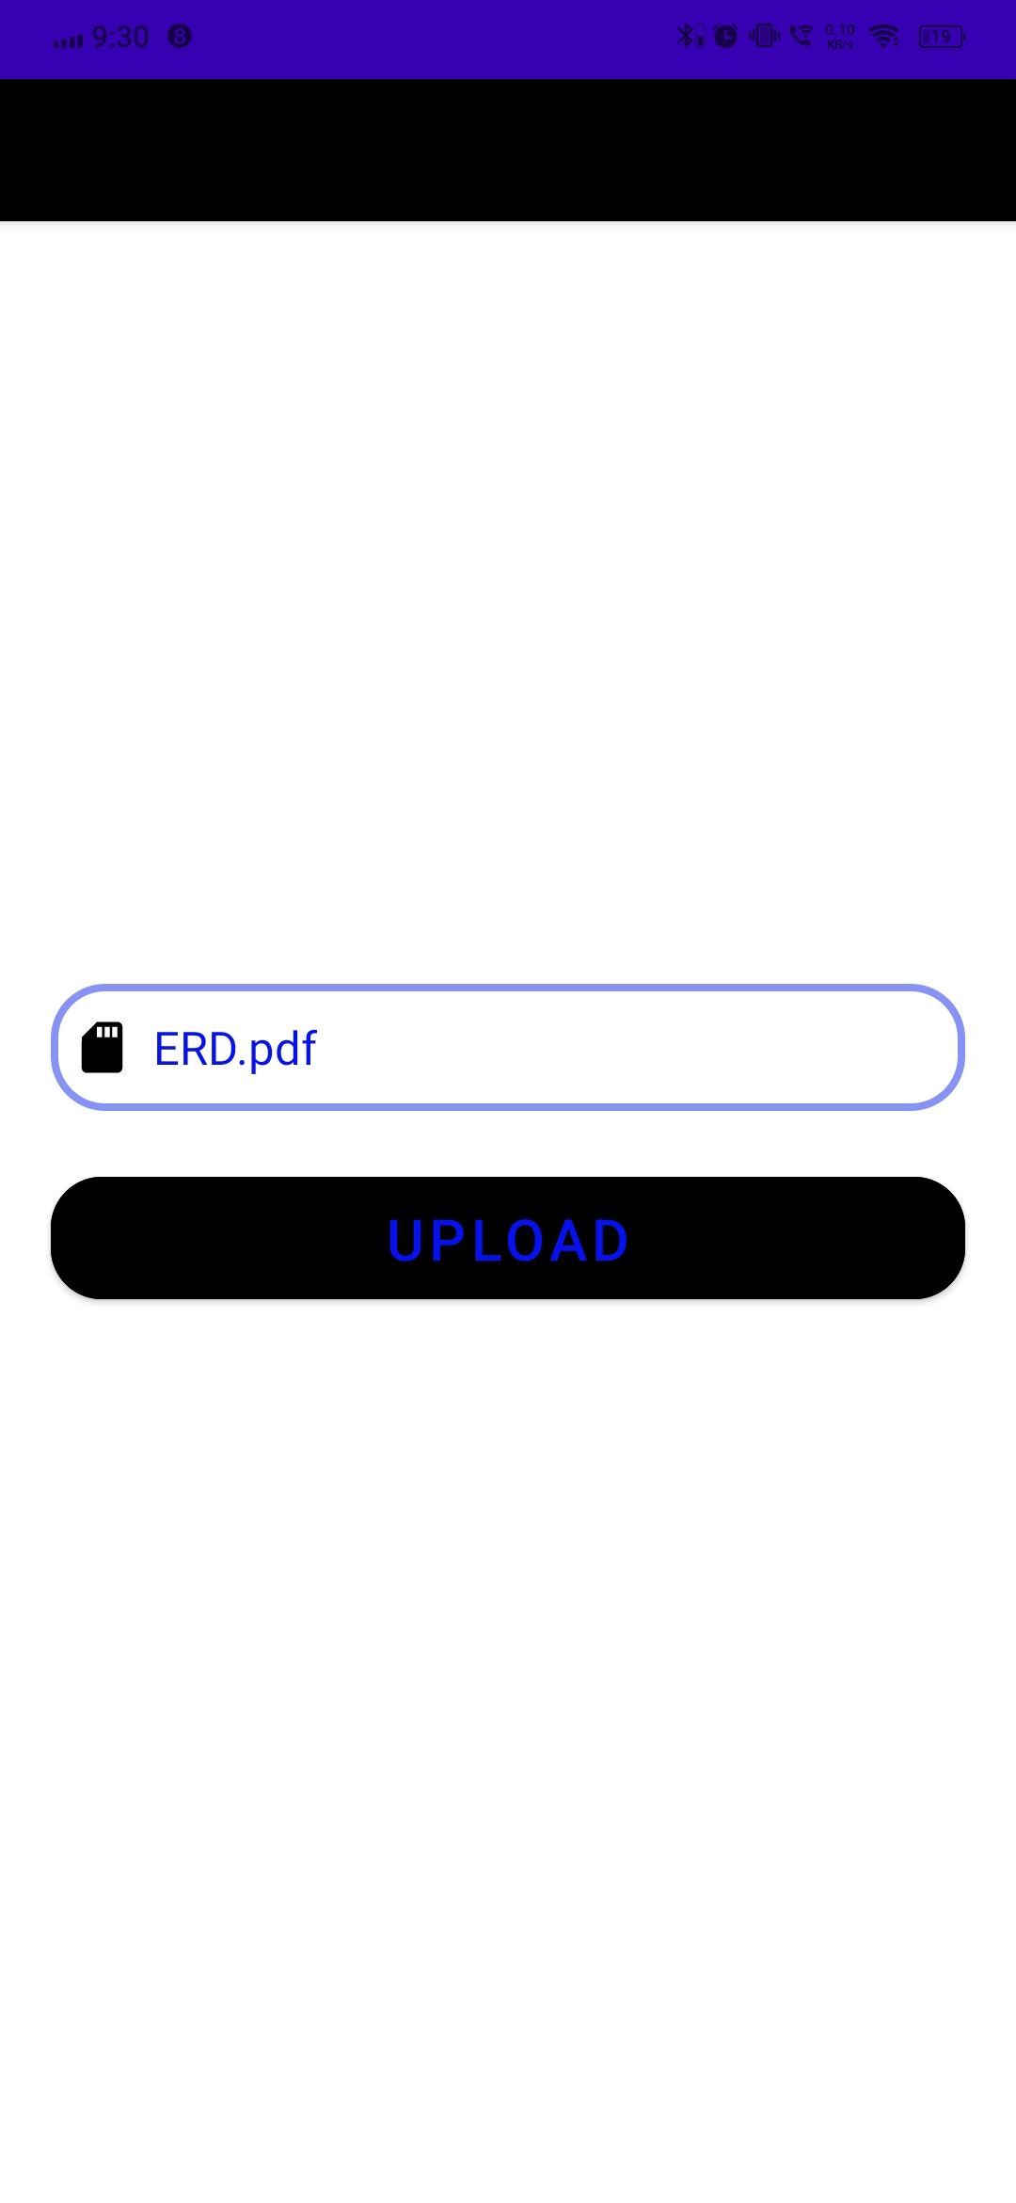
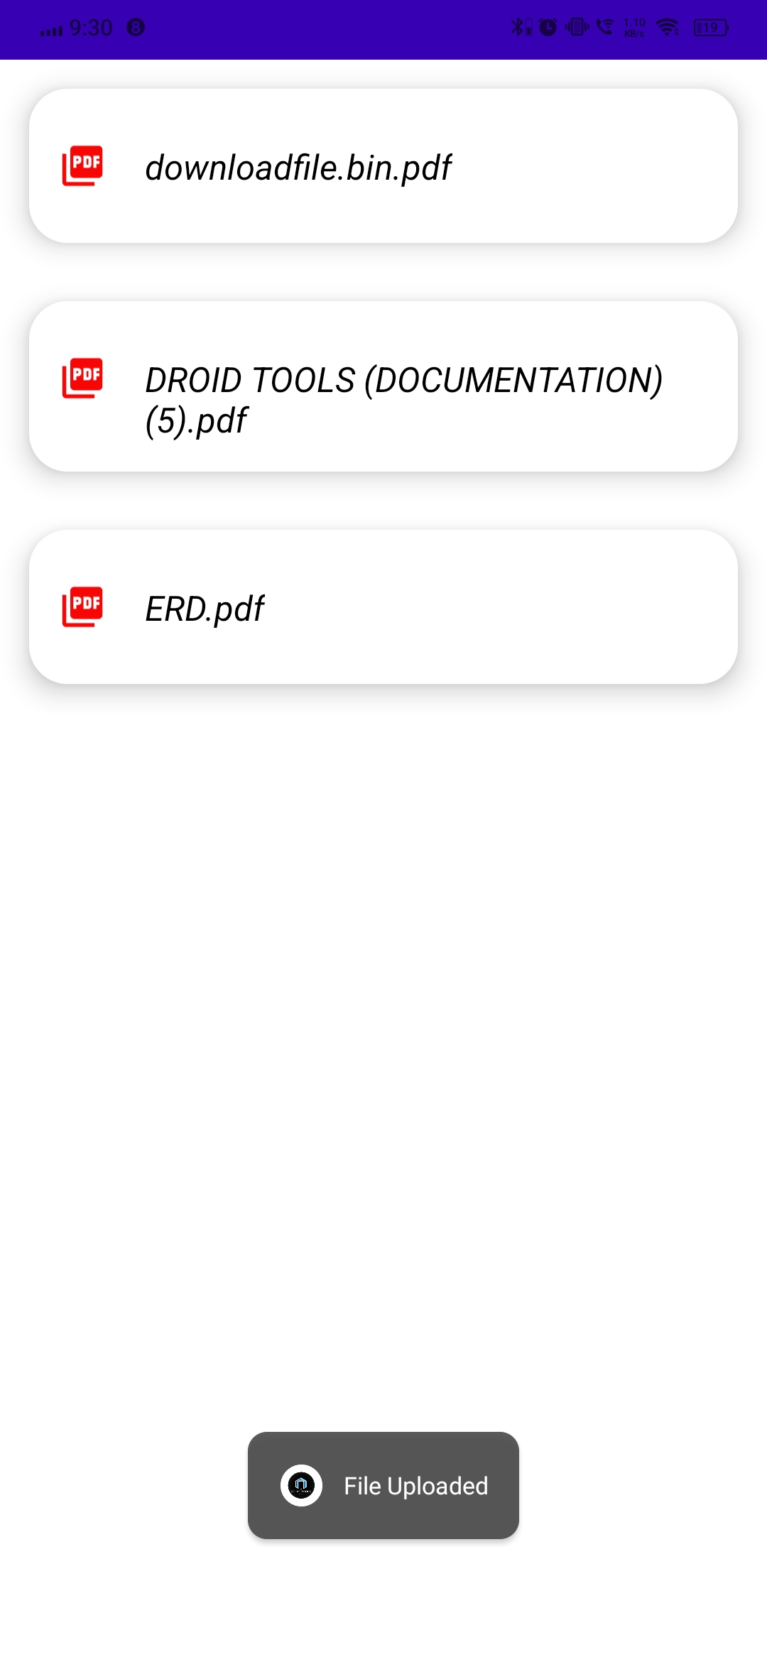
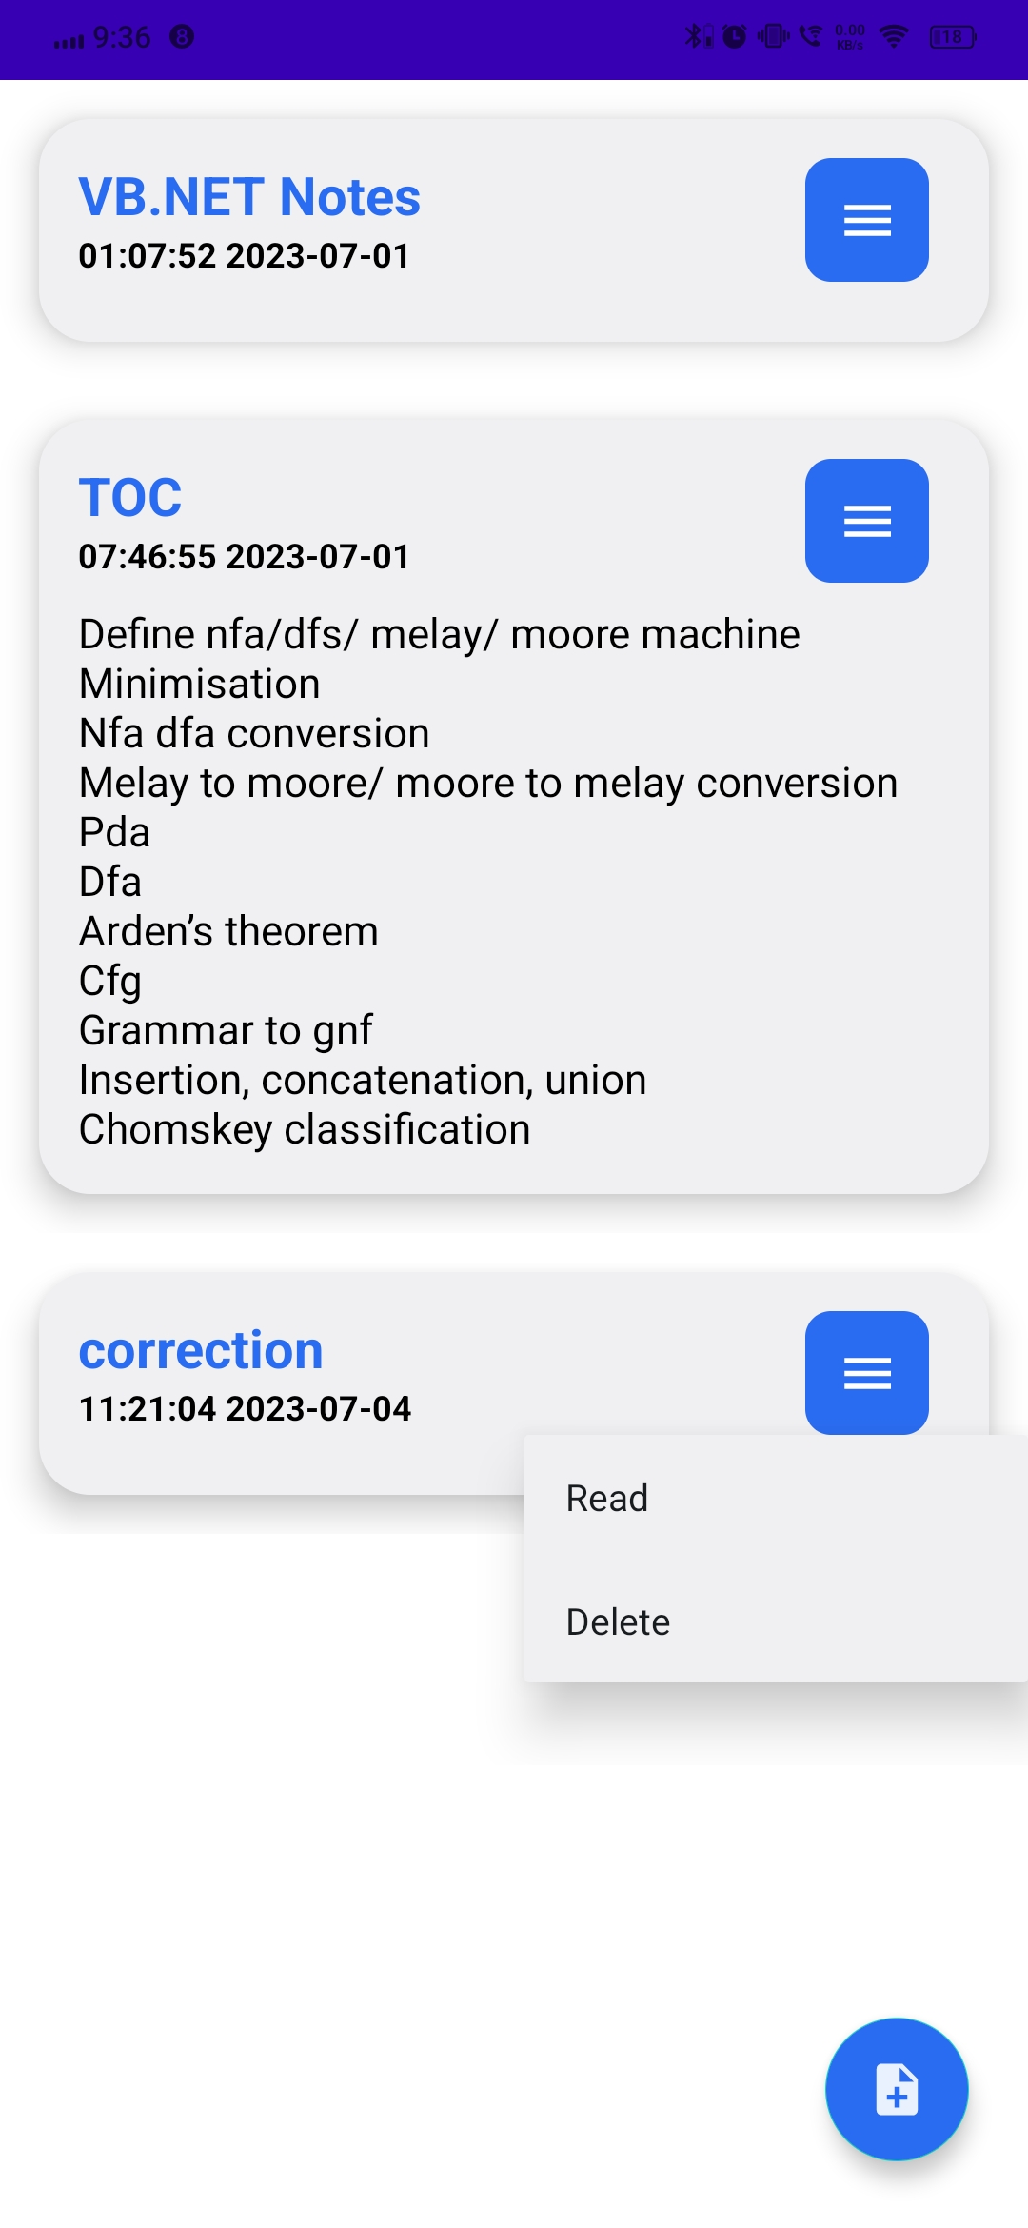
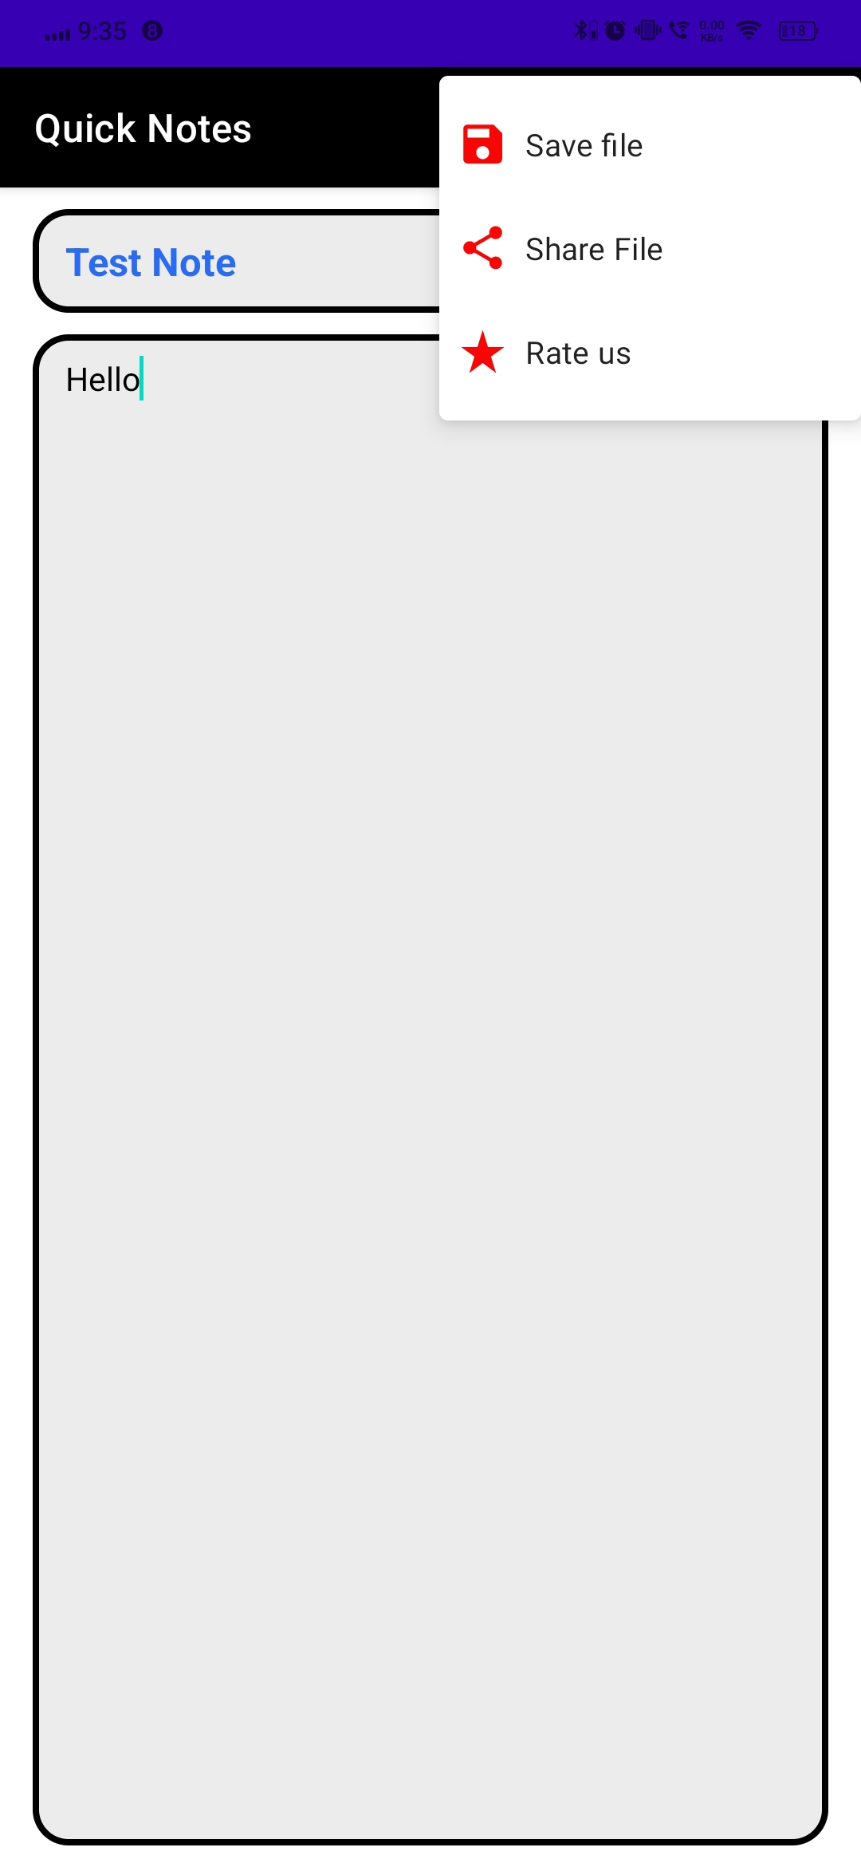
Snapshots Three
File Access From
Server
File Upload On Server
Droid
tools
Save
Notes
Read / Delete Notes

Slide 7
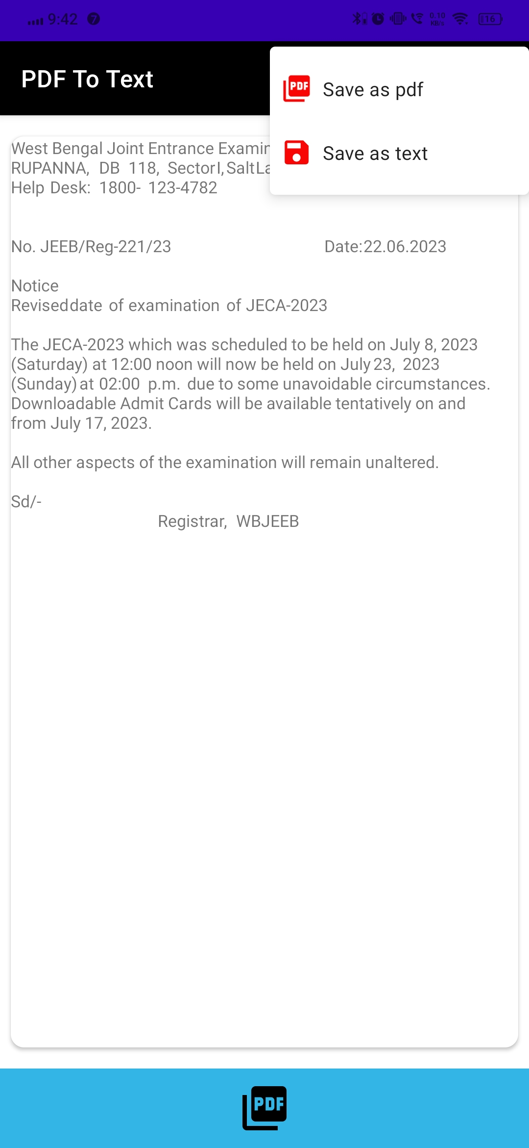
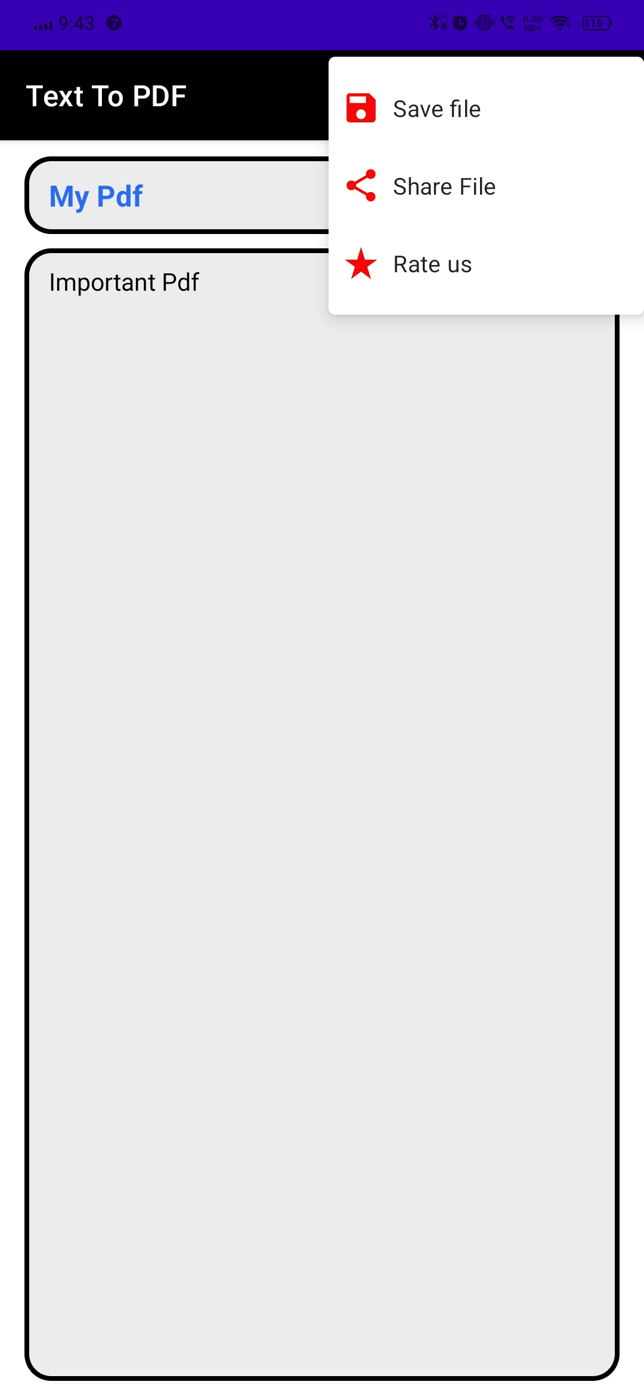
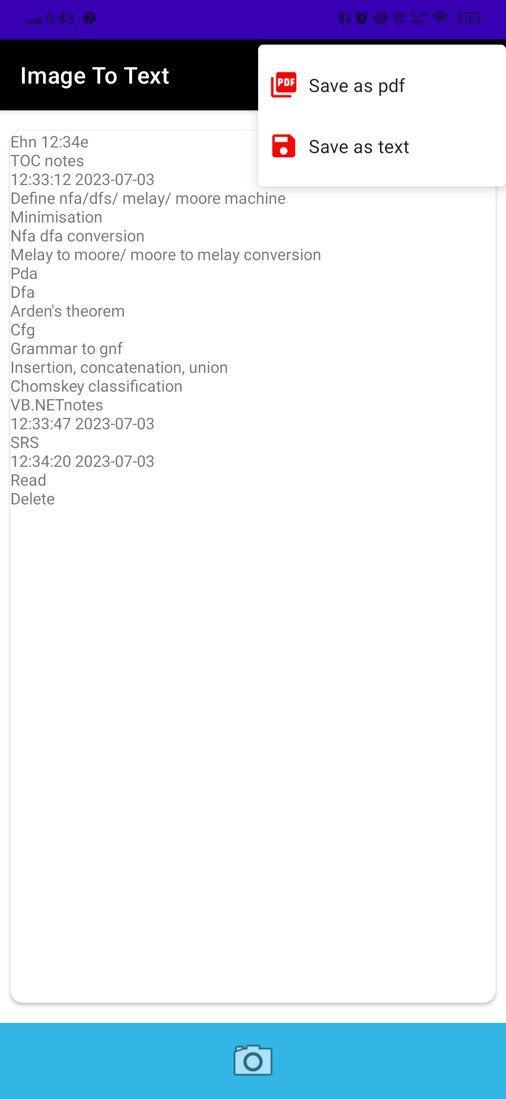
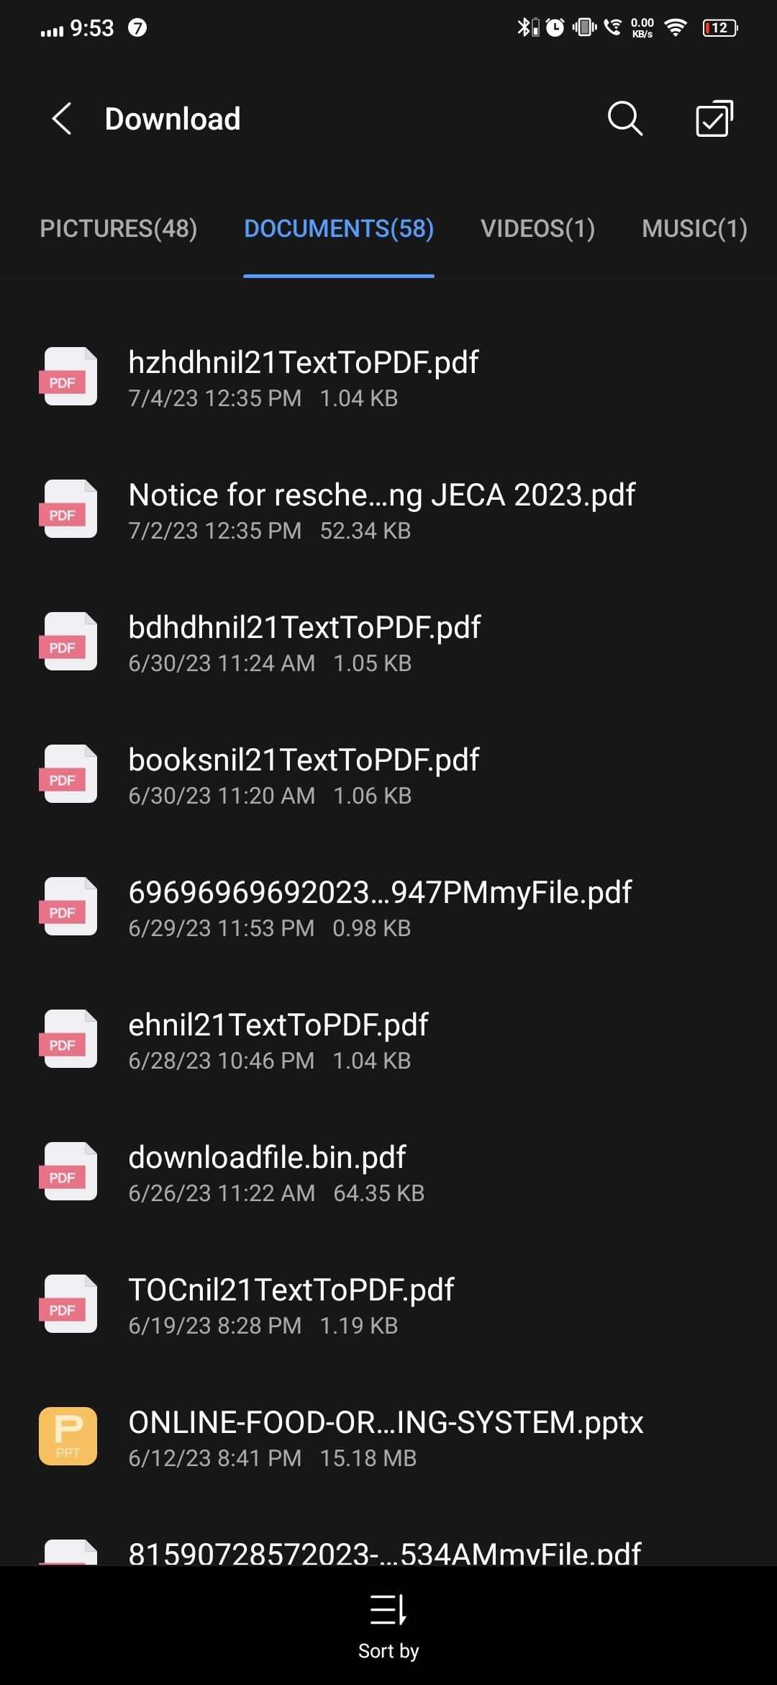
Snapshots Four
PDF
To
Text
Text
To
PDF
Droid
tools
PDF Are in users phone
Image
To
Text

Slide 8
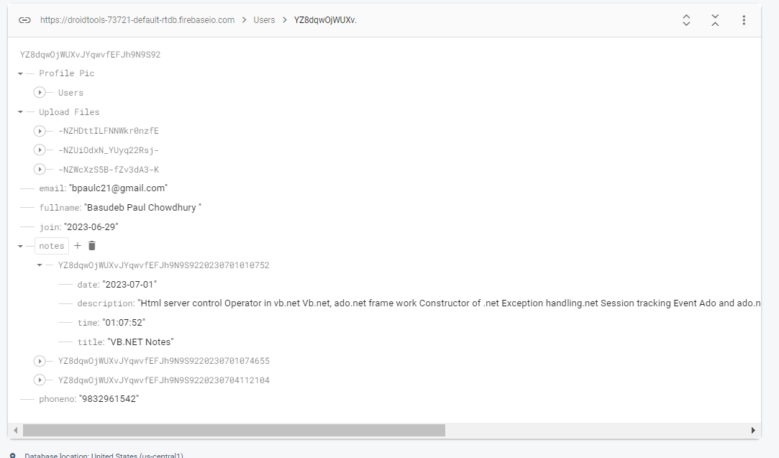
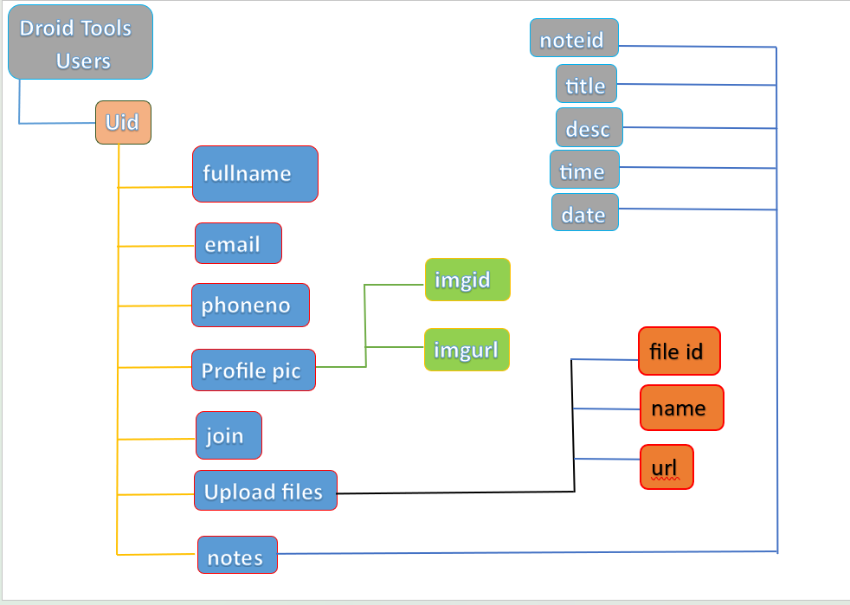
Database
Database Structure
Data Of A User

Slide 9
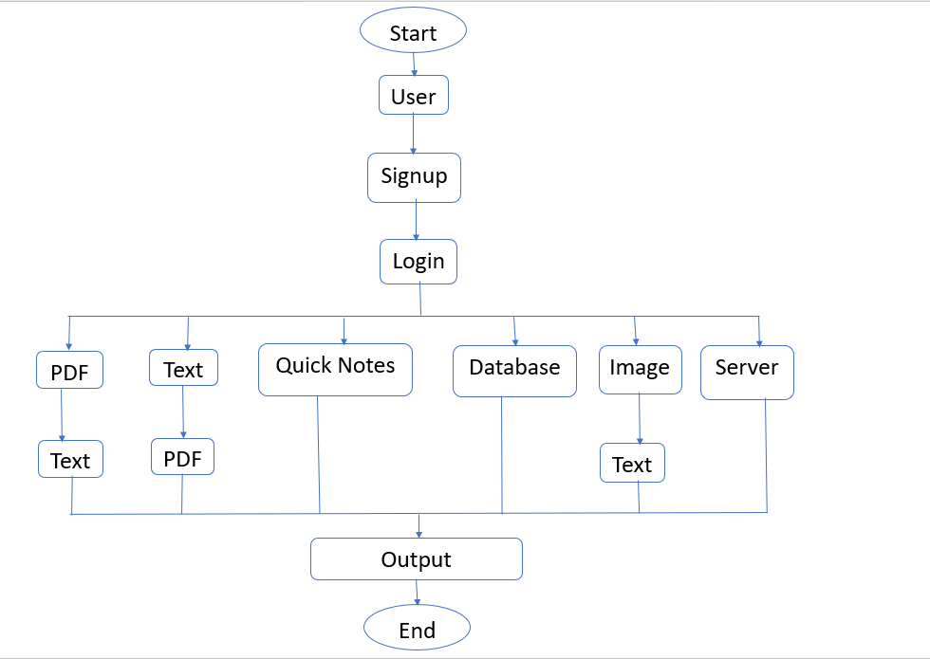
Flow Chart
Droid Tools

Slide 10
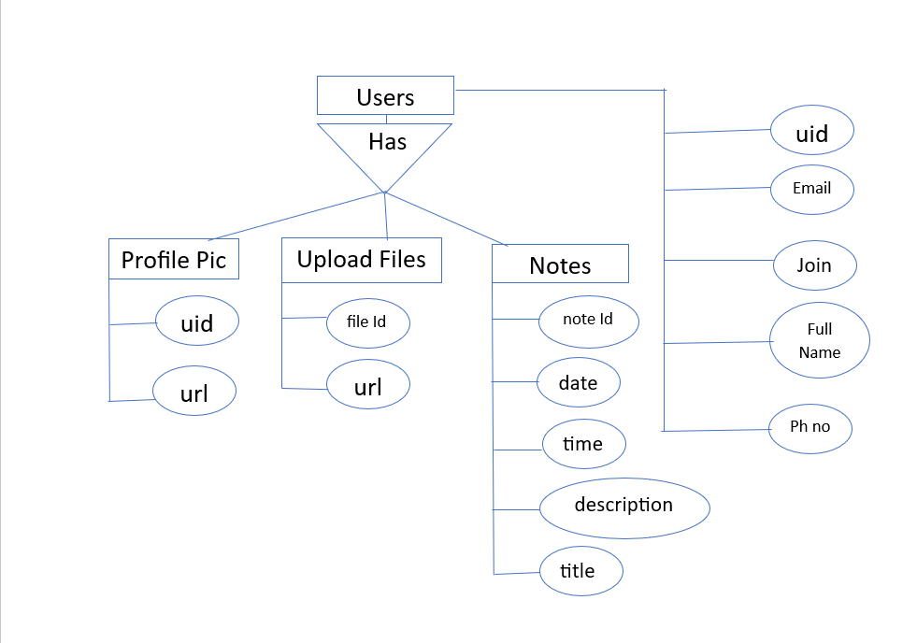
ERD
Droid Tools

Slide 11
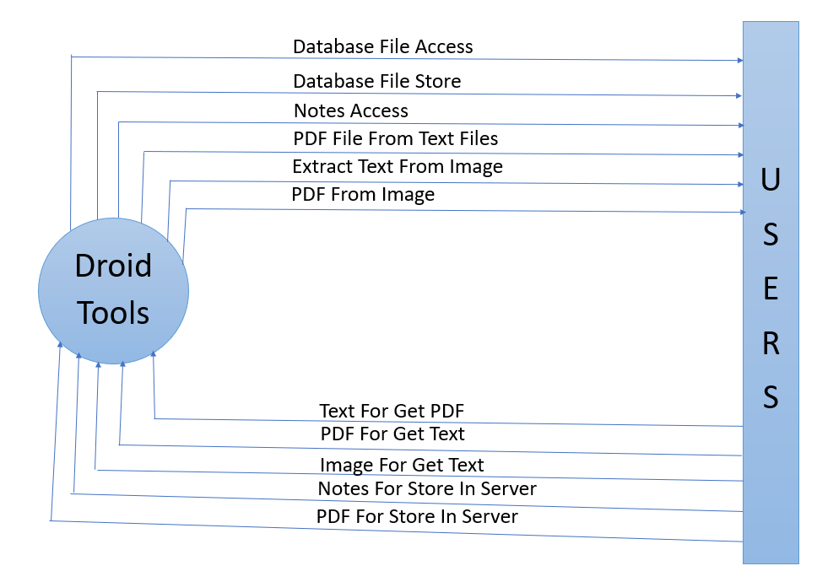
DFD Level - 0
Droid Tools

Slide 12
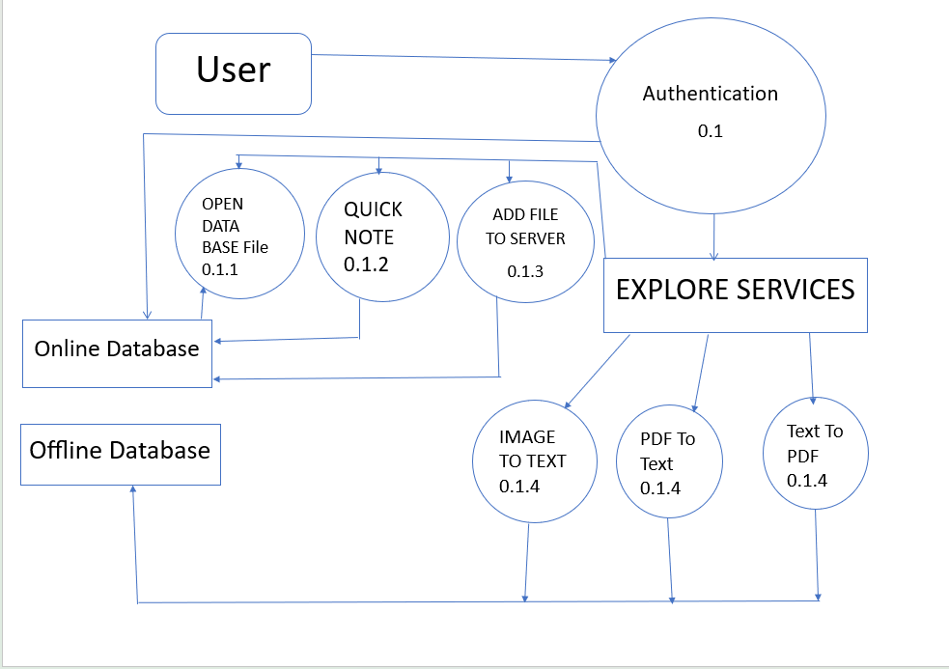
DFD Level - 1
Droid Tools

Slide 13

Advantages And Disadvantages
Advantages
Disadvantages
User will be able to edit the text /pdf /image file in our droid tools app.
Every user can store their pdf files in the server.
Users can store notes in server and access from any android device.
For file storing features user have a flexibility for access file from any where and they not have to carry pen drive or any storage device.
Every users have deprecated storage to store their file or documents.
Only authorized users can use this apps.
One of the disadvantages of text files is that the file do not contain any text formatting features.
You can upload your files for 30 days only
There is no notify system after auto delete.
You can’t share your file.
In image to text converter features only the English texts can be extract. It doesn’t identify other languages.
User login details not stored. So users have to login every time while they have use the application.
Droid Tools

Slide 14
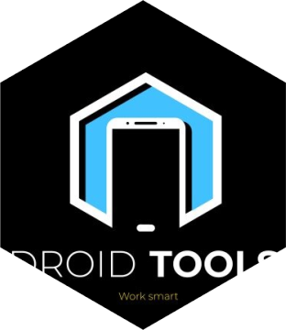

Future Scope
When directing the phone's camera at an object, droid tool will attempt to identify the object by reading barcodes, QR codes, labels and text, and show relevant search results, web pages, and information.
Droid tool can crop PDF pages, change their order, manipulate hyperlinks, digitally sign a PDF file, add comments, redact certain parts of the PDF file, and ensure its adherence to such standards.
In DBMS the importance of collecting, storing, and analyzing data increases day by day, the use of improved and analyze our data according to the database management systems.
We are able to create auto generated cv.
We are able to extract voice from video.
Droid tools is able translate text into most languages are loaded.
We can change the format of the image.

Slide 15
Conclusion
Throughout this presentation, we have highlighted the key features and benefits of our app, emphasizing its ability to convert text to PDF and vice versa, convert images to text, provide cloud storage, and enable quick note-taking.
Furthermore, our app's image-to-text conversion feature offers a convenient solution for extracting text from images. Users can simply capture or upload an image, and our app will convert it into editable text, making it easy to extract information, save time, and enhance productivity.
The cloud storage facility provided by our application offers a secure and convenient way for users to store and access their files.
Additionally, our app includes a quick note-taking feature that allows users to capture and save important thoughts, ideas, or reminders on the go.
We are confident that our application will meet the needs of users seeking a comprehensive tool for their file management, conversion, and note-taking requirements.

Slide 16




Thank you
For giving your valuable time.

